Slide 1
Git
Setup your GIT

Slide 2

What is GitHub?
Founded in 2008
Web based version control and source
control management using git
31m users; 100m repositories
Acquired by Microsoft on June 2018
for $7.5b

Slide 3





Slide 4
Glossary
Branch
A branch is a parallel version of a repository. It is contained within the repository, but does not affect the primary or master branch allowing you to work freely without disrupting the "live" version. When you've made the changes you want to make, you can merge your branch back into the master branch to publish your changes. For more information, see "About branches."
Clone
A clone is a copy of a repository that lives on your computer instead of on a website's server somewhere, or the act of making that copy. With your clone you can edit the files in your preferred editor and use Git to keep track of your changes without having to be online. It is, however, connected to the remote version so that changes can be synced between the two. You can push your local changes to the remote to keep them synced when you're online.
Commit
A commit, or "revision", is an individual change to a file (or set of files). It's like when you save a file, except with Git, every time you save it creates a unique ID (a.k.a. the "SHA" or "hash") that allows you to keep record of what changes were made when and by who. Commits usually contain a commit message which is a brief description of what changes were made.

Slide 5
Glossary
Fetch
Fetching refers to getting the latest changes from an online repository without merging them in. Once these changes are fetched you can compare them to your local branches (the code residing on your local machine).
Fork
A fork is a personal copy of another user's repository that lives on your account. Forks allow you to freely make changes to a project without affecting the original. Forks remain attached to the original, allowing you to submit a pull request to the original's author to update with your changes. You can also keep your fork up to date by pulling in updates from the original.
Markdown
Markdown is a simple semantic file format, not too dissimilar from .doc, .rtf and .txt. Markdown makes it easy for even those without a web-publishing background to write prose (including with links, lists, bullets, etc.) and have it displayed like a website. GitHub supports Markdown, and you can learn about the semantics.

Slide 6
Glossary
Pull
Pull refers to when you are fetching in changes and merging them. For instance, if someone has edited the remote file you're both working on, you'll want to pull in those changes to your local copy so that it's up to date.
Pull request
Pull requests are proposed changes to a repository submitted by a user and accepted or rejected by a repository's collaborators. Like issues, pull requests each have their own discussion forum. For more information, see "About pull requests."
Push
Pushing refers to sending your committed changes to a remote repository, such as a repository hosted on GitHub. For instance, if you change something locally, you'd want to then push those changes so that others may access them.
https://help.github.com/articles/github-glossary/

Slide 7
Sign-up
Signup to create a username and password and associate them with your email
Free account gives you the opportunity to work on other people’s projects and create your own public repos.
To create your own private repos, you need to upgrade to a paid subscription (unless a verified student, teacher or academic researcher)
https://github.com

Slide 8
GitHub Desktop
Easiest way to sync GitHub repos and also install Git (Mac/Windows)
Test for install

Slide 9
Install Git (git-scm.com)
Download and run the current Git installer for your Operating System
https://git-scm.com/downloads

Slide 10
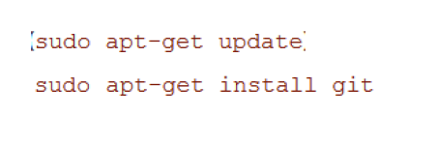
Install Git (Windows subsystem for Linux)
On Windows 10, install Git in your Linux Bash shell
Normal install with apt-get
https://docs.microsoft.com/en-us/windows/wsl/about

Slide 11
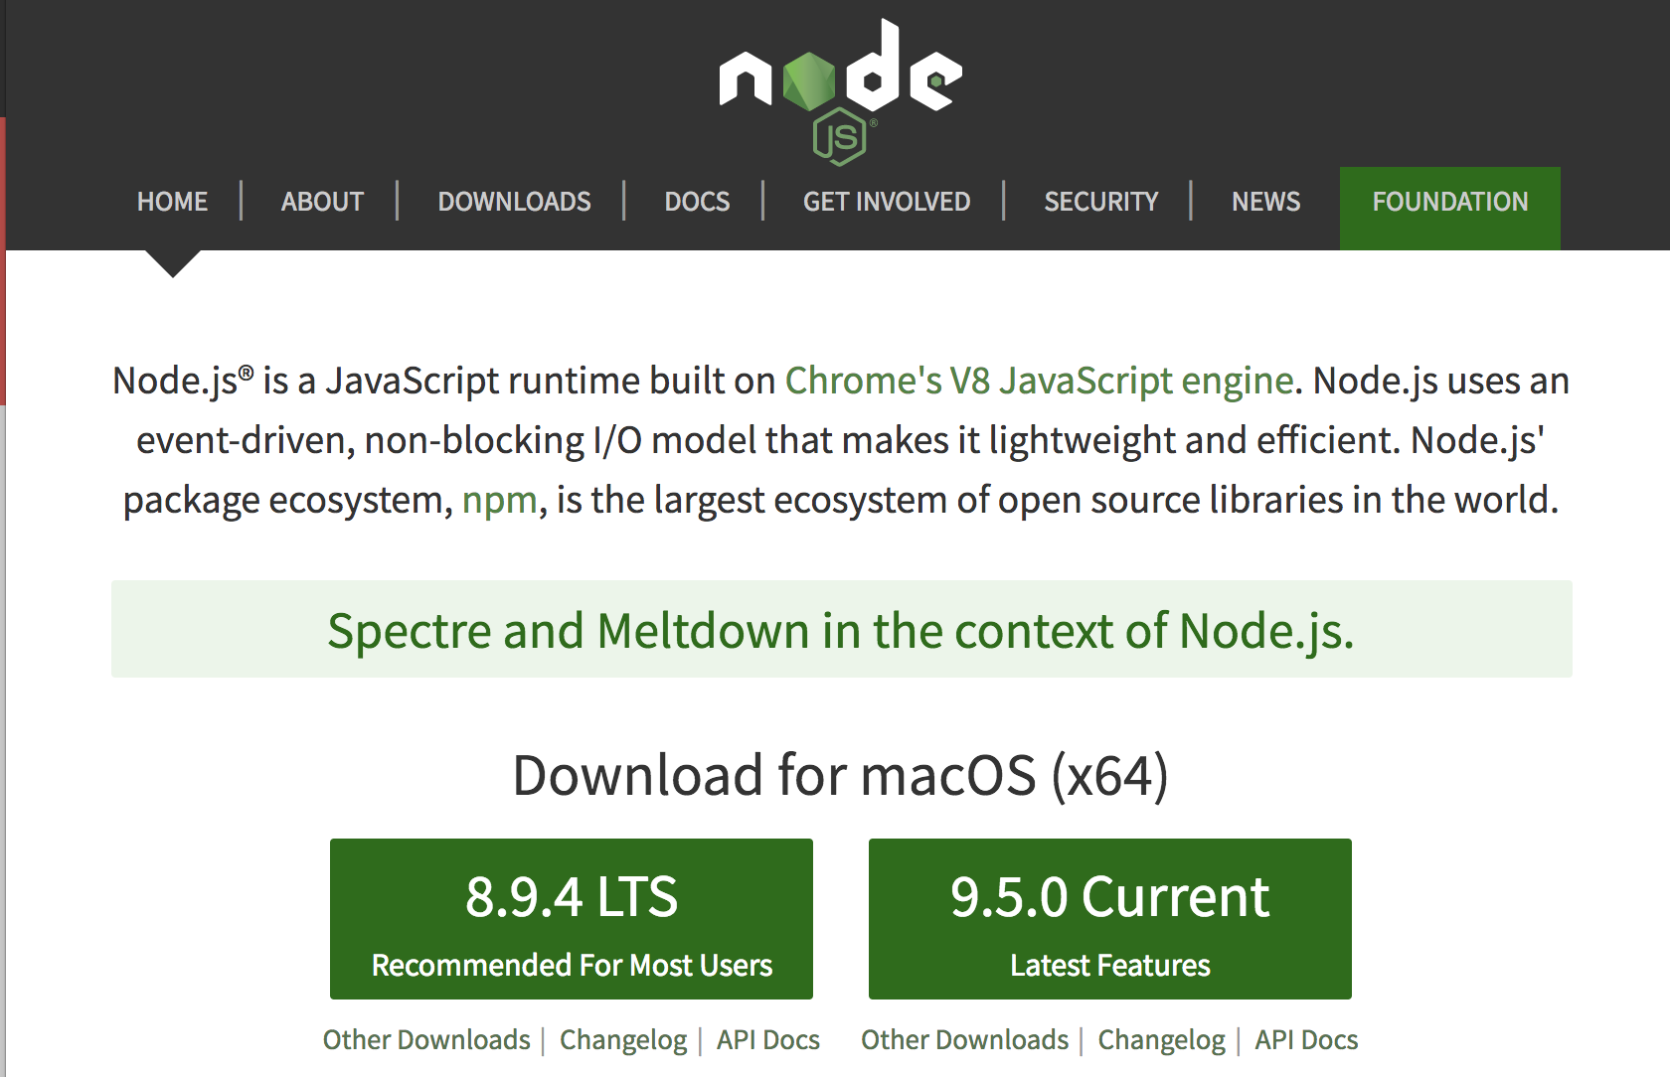
NodeJS
Go ahead and visit the node website⁴⁰and download Node. Run through the installation and you’ll have Node and npm installed!

Slide 12
Mac
Mac install of Node
To sudo or not to sudo
It is cleaner not to use sudo when installing npm packages there are a couple of options here on how this is done.
You can run the command below so the node_modules has the permissions so you can install node modules globally (e.g. –g flag)
sudo chown -R $(whoami) $(npm config get prefix)/{lib/node_modules,bin,share}

Slide 13
Create New REPO

Slide 14
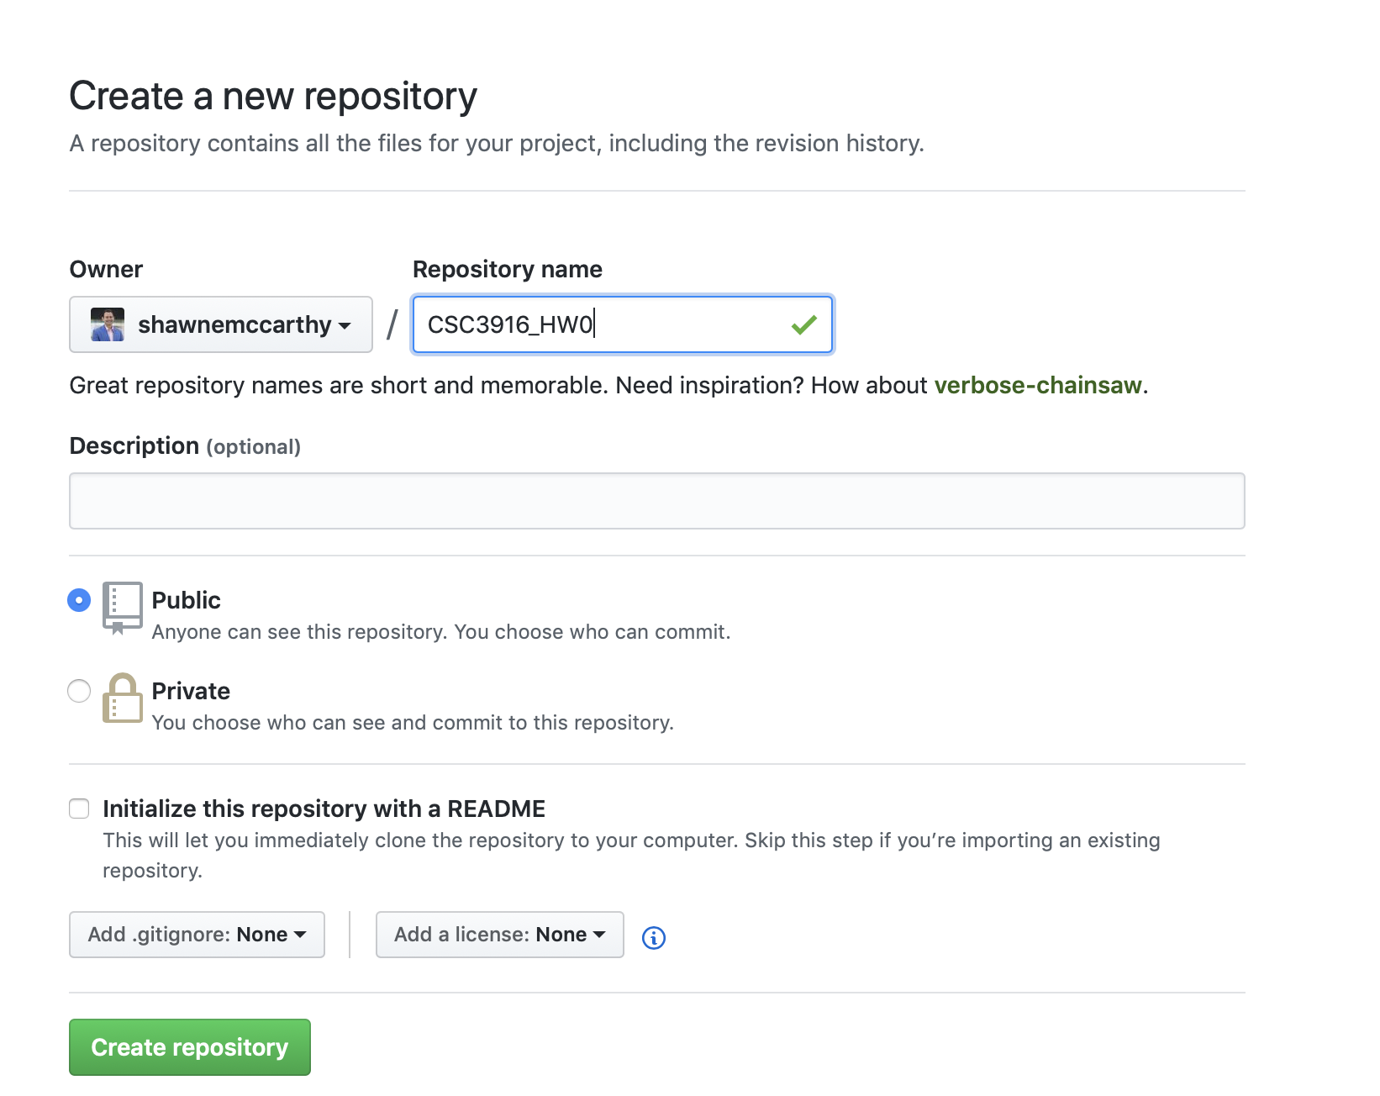
REPO
Create REPO CSC3916_HW0 on github.com

Slide 15
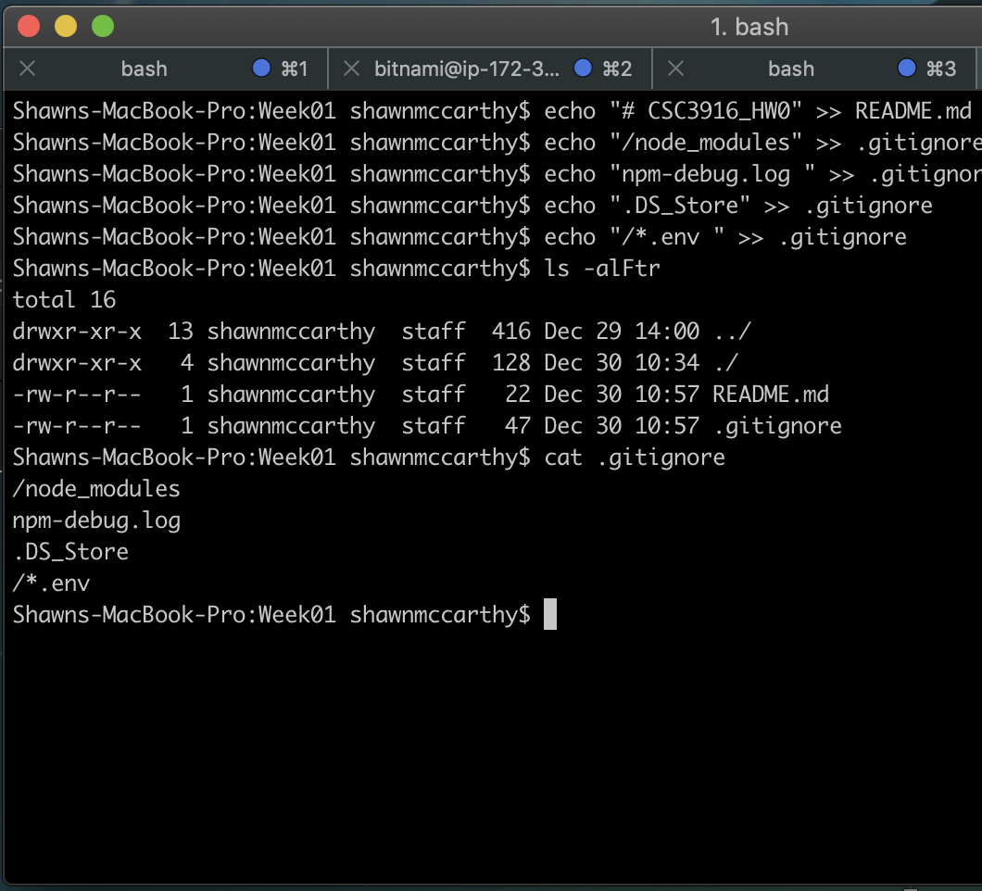
From Terminal
Create REPO CSC3916_HW0 on github.com
From you root directory run
echo "# CSC3916_HW0" >> README.md
echo "/node_modules" >> .gitignore
echo "npm-debug.log " >> .gitignore
echo ".DS_Store" >> .gitignore
echo "/*.env " >> .gitignore

Slide 16
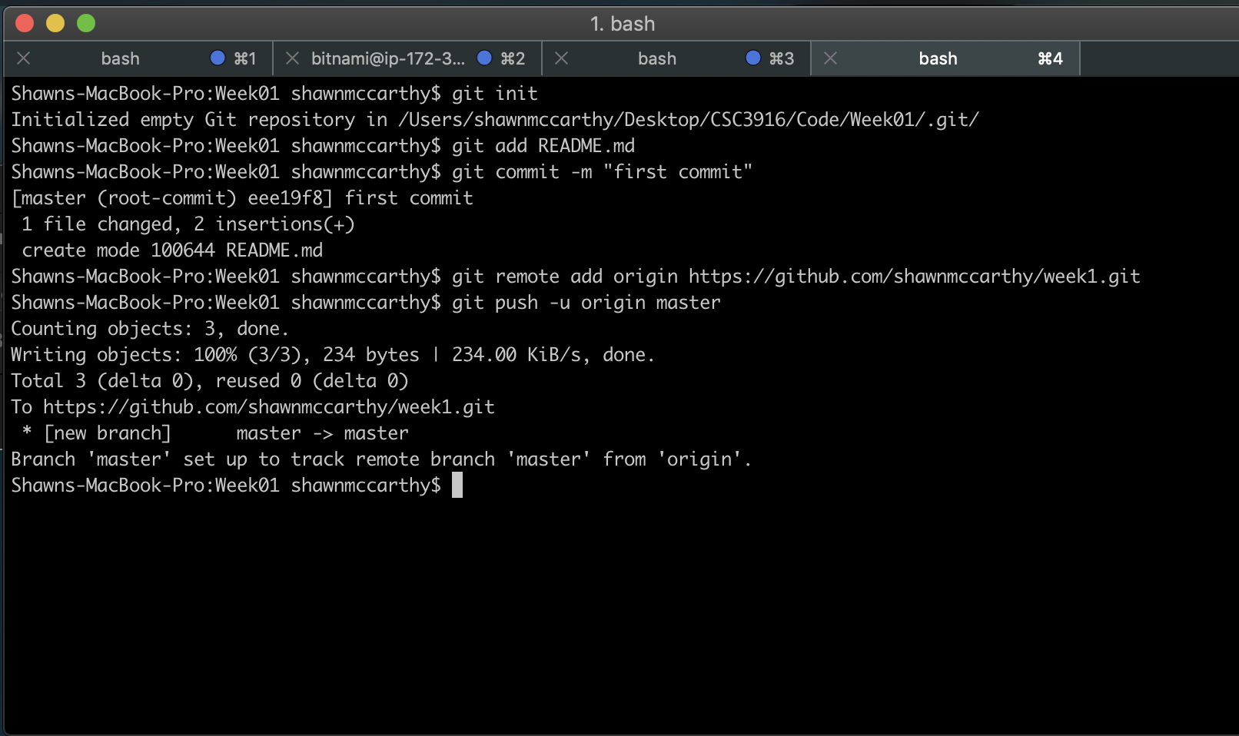
Git add
git init
git add README.md
git commit -m "first commit"
git remote add origin https://github.com/shawnmccarthy/week1.git
git push -u origin master

Slide 17
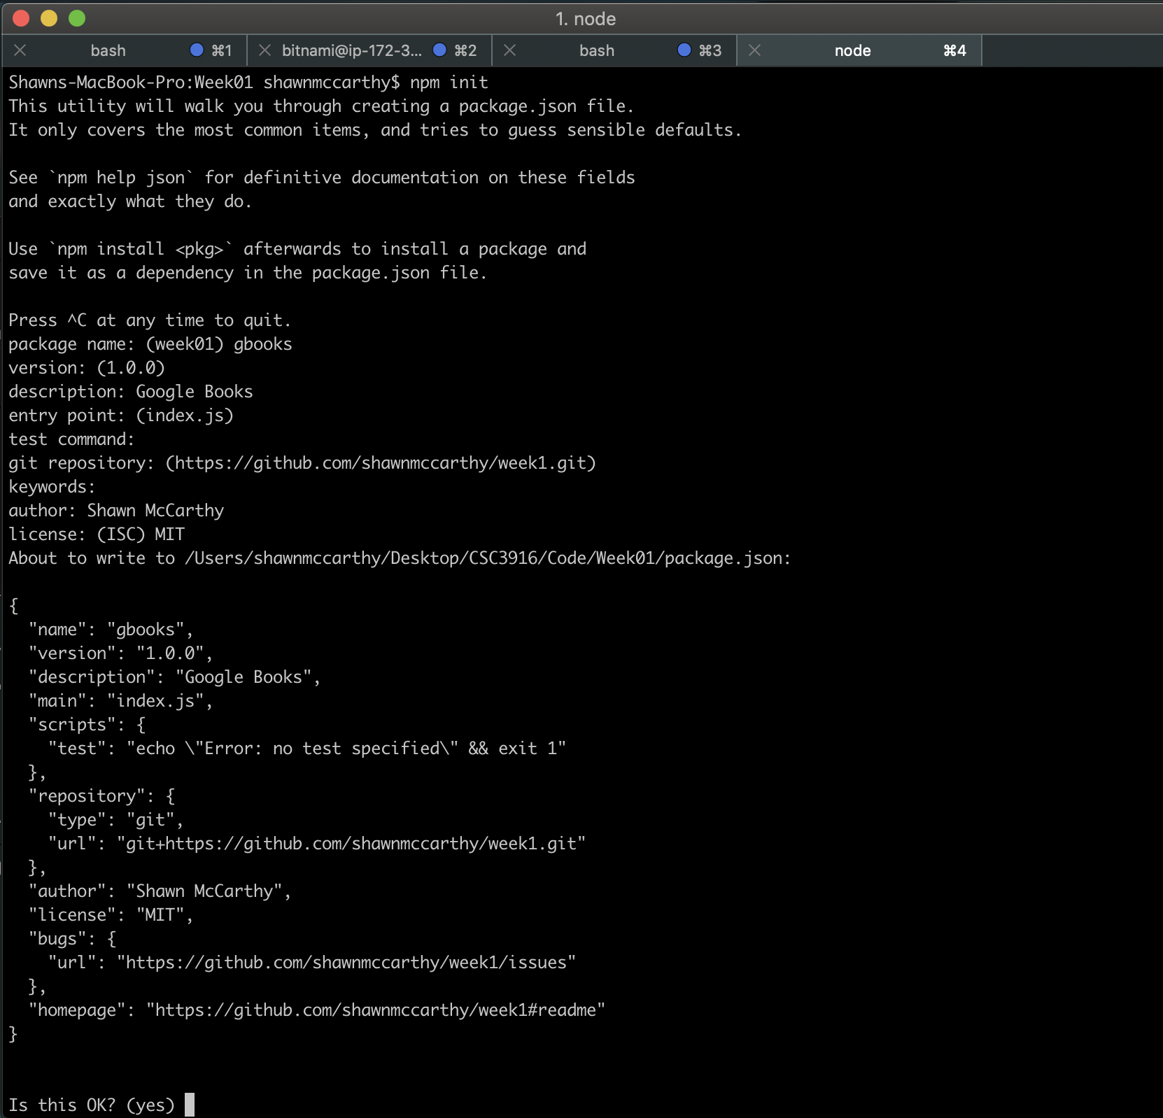
npm Init

Slide 18
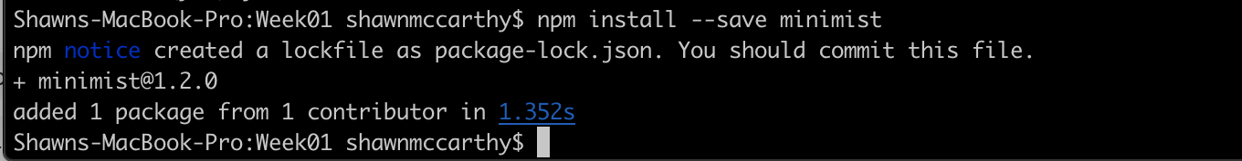
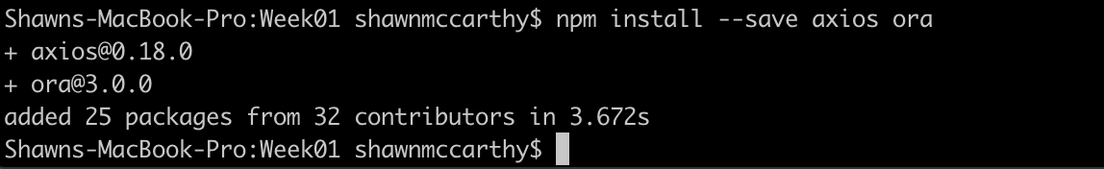
Add Packages

Slide 19
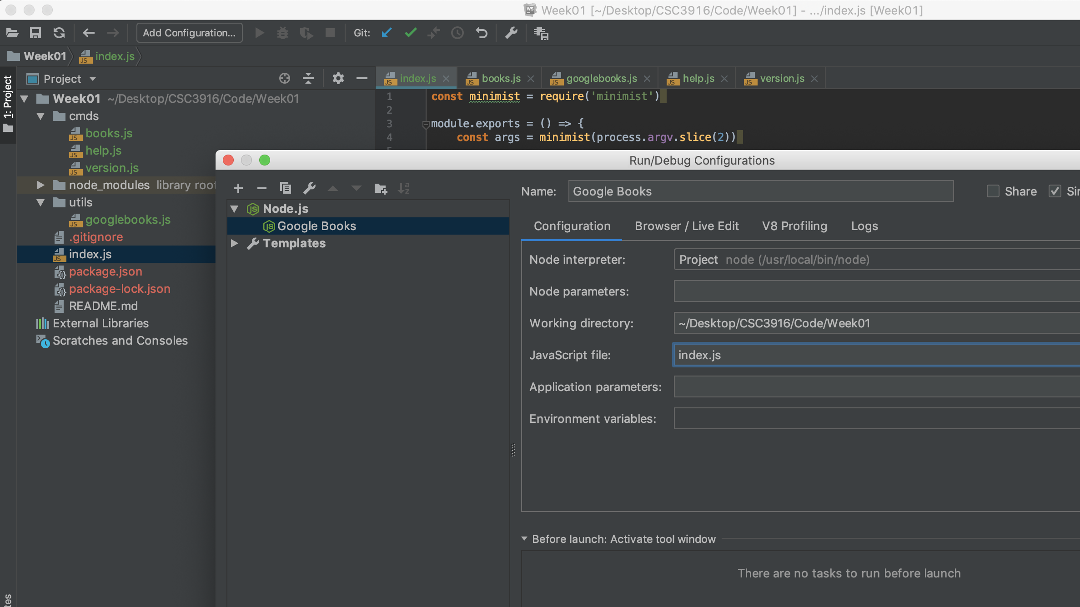
Add Config

Slide 20
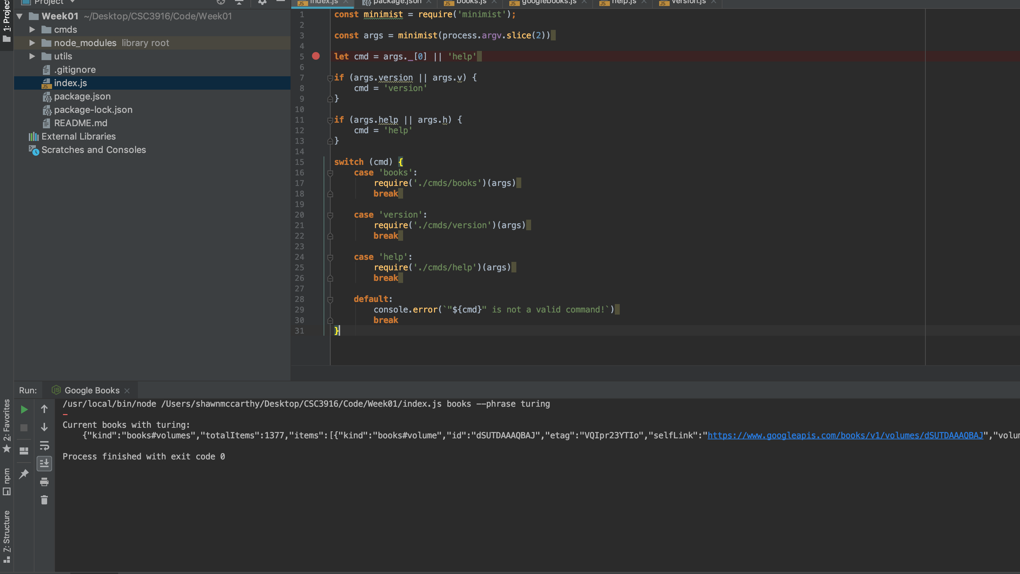
Build Program

Slide 21
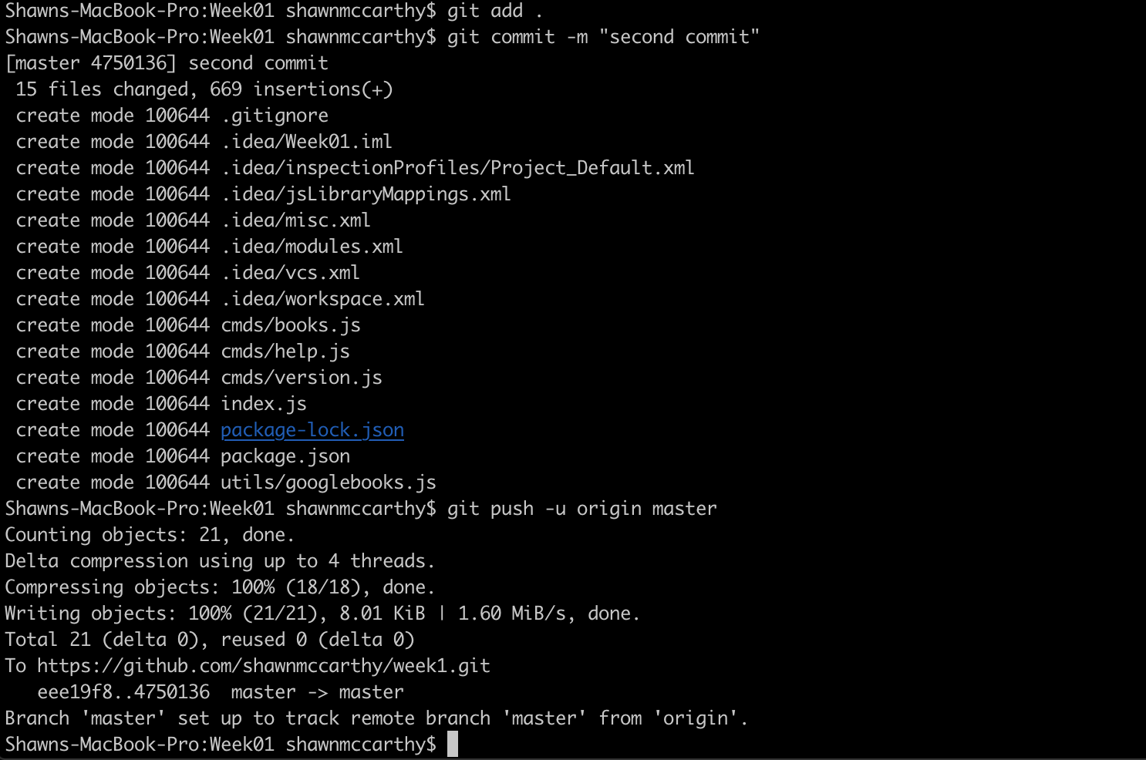
Push to GitHub
git add .
git commit -m "second commit”
git push -u origin master

Slide 22
More Git
Clone and working in teams

Slide 23
Clone a REPO
In real life people mostly write code & docs on their own machines, not online.
Go to the code pane of the repo and click on the green “Clone or download” button.
We don’t want to download a Zip; instead, we want to clone the repo with Git or GitHub Desktop.

Slide 24
Clone a REPO
If you installed GitHub Desktop, click on “Open in Desktop.”
Your GitHub Desktop would look something like the image to the right once the clone finished:
Click on the copy icon to the right of the URL for your repo and paste the URL into a console after the command git clone

Slide 25
GitHub Flow
The GitHub flow is a lightweight, branch-based workflow built around core Git commands used by teams around the globe—including ours.
The GitHub flow has six steps, each with distinct benefits when implemented:
Create a branch: Topic branches created from the canonical deployment branch (usually master) allow teams to contribute to many parallel efforts. Short-lived topic branches, in particular, keep teams focused and results in quick ships.
Add commits: Snapshots of development efforts within a branch create safe, revertible points in the project’s history.
Open a pull request: Pull requests publicize a project’s ongoing efforts and set the tone for a transparent development process.
Discuss and review code: Teams participate in code reviews by commenting, testing, and reviewing open pull requests. Code review is at the core of an open and participatory culture.
Merge: Upon clicking merge, GitHub automatically performs the equivalent of a local ‘git merge’ operation. GitHub also keeps the entire branch development history on the merged pull request.
Deploy: Teams can choose the best release cycles or incorporate continuous integration tools and operate with the assurance that code on the deployment branch has gone through a robust workflow.

Slide 26
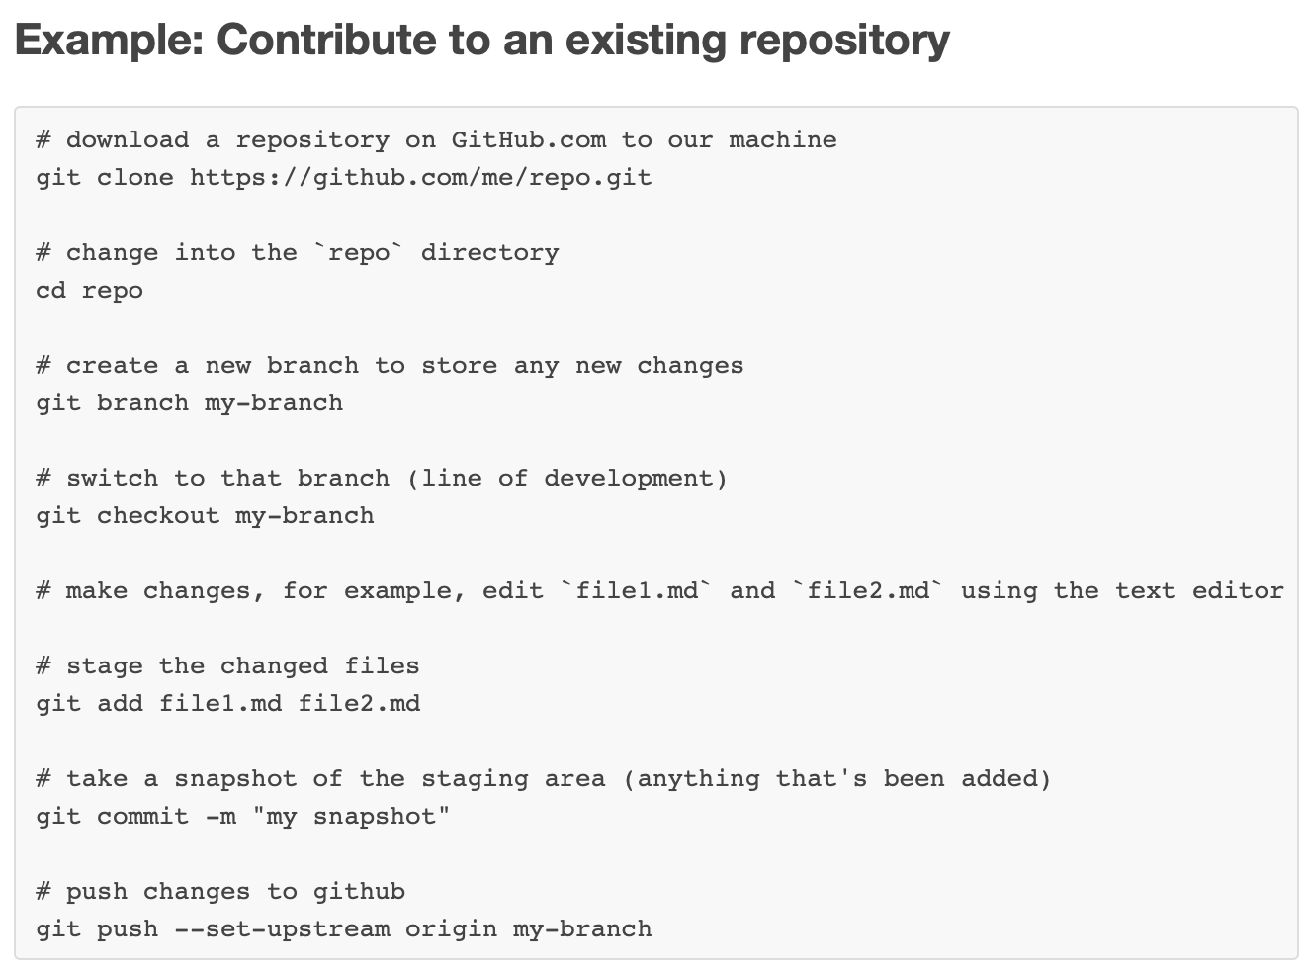

Slide 27
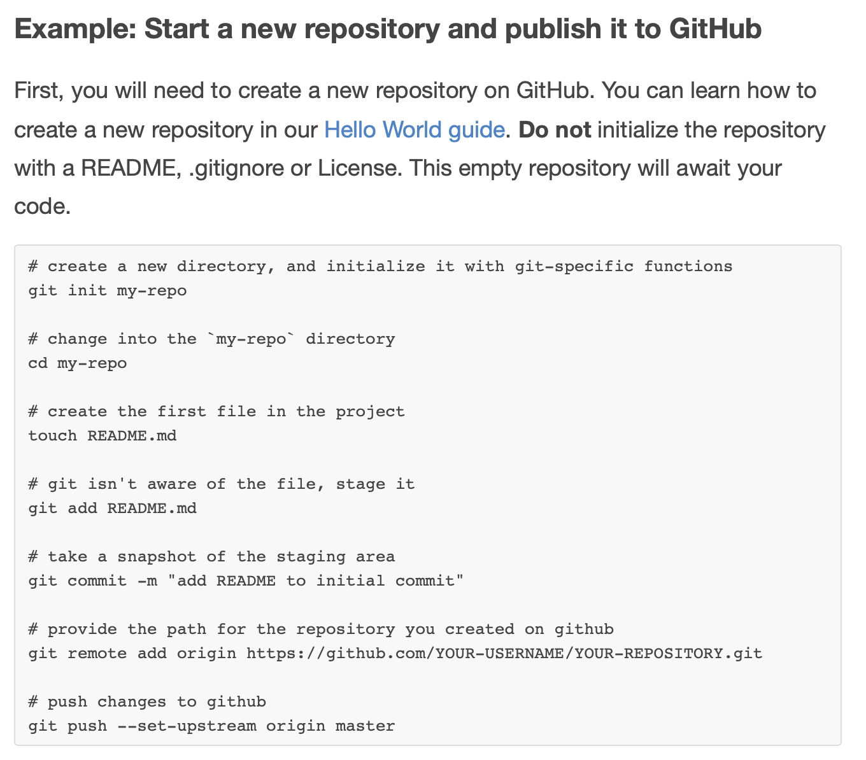

Slide 28
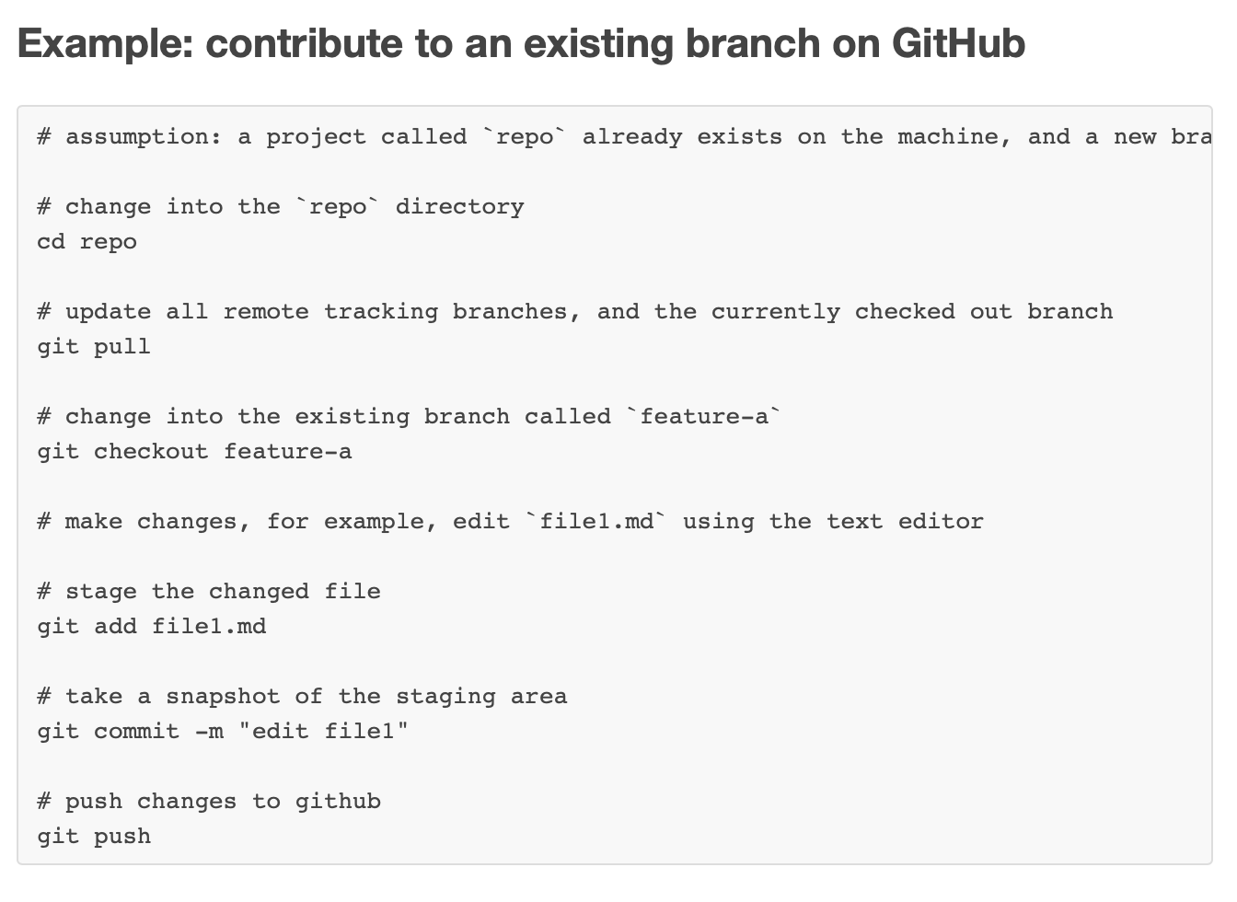

Slide 29
Hello World Guide
https://guides.github.com/activities/hello-world/#repository

